Slide 1
REST
Applied Web Architecture – TAWK17
Lecture Workshop 5
2017-09-29
Jasmin Jakupovic

Slide 2
What do we learn today?
Use of REST API
Facebook API
Google API
Instagram API
Connecting APIs with PHP
Use of GitHub
A video tutorial will be provided (not recorded by me) in the reference list
How to proceed with your Lab project (Lab5)

Slide 3
Use of REST API
Collect resources from another source and present it in a desired place
E.g. you can use the Facebook API to find out how many likes a certain page has
E.g. you can use the Google API to
E.g. you can use the Instagram API to
You will integrate a couple of APIs to your own website (labs)
Maybe this inspires you to do it in your project as well!?

Slide 4
Facebook API
To learn more visit: https://developers.facebook.com/docs/graph-api/
Facebook changed their API so you have limited information
You also need to create an access token
This helps them identify who is taking what info (analytics?)
E.g. you post “Hello, world” on your timeline:
FB.login(function()
{ // Note: The call will only work if you accept the permission request
FB.api('/me/feed', 'post', {message: 'Hello, world!'}); }
, {scope: 'publish_actions'});

Slide 5
Google API
To learn more visit https://developers.google.com/maps/
Use any address to get an machine readable GPS location
http://maps.googleapis.com/maps/api/geocode/json?address=London
The server is ‘maps.googleapis.com’
What resource are we accessing? Address? How do we get to it?
Resource: /maps/api/geocode/json
We selected to receive data in a JSON format (other formats supported as well)
Parameters: ?address=Jönköping
What is the output going to be?

Slide 6
Google API (2)
{
"results" : [
{
"address_components" : [
{
"long_name" : "Jönköping",
"short_name" : "Jönköping",
"types" : [ "locality", "political" ]
},
{
"long_name" : "Jonkoping County",
"short_name" : "Jonkoping County",
"types" : [ "administrative_area_level_1", "political" ]
},
{
"long_name" : "Sweden",
"short_name" : "SE",
"types" : [ "country", "political" ]
}
] ... Continues….

Slide 7
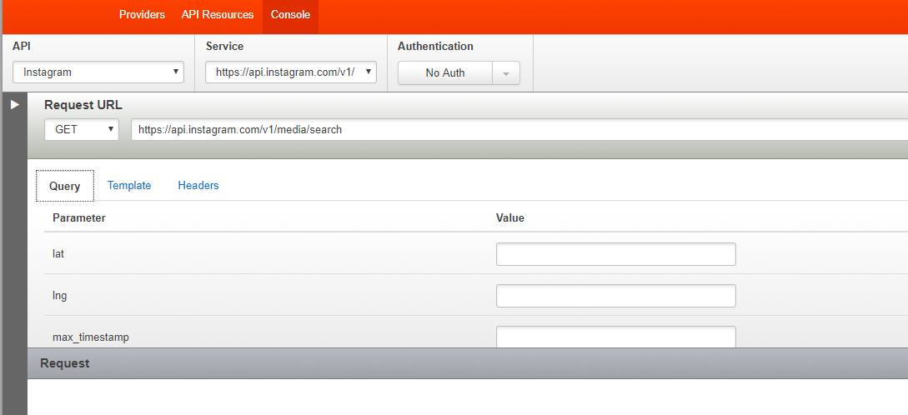
Instagram API
To learn more visit https://www.instagram.com/developer
We use apigee.com to work with the Instagram API
https://apigee.com/console/instagram
E.g. we will search for media (pictures/posts) on Instagram
The API call should look like this: https://api.instagram.com/v1/media/search

Slide 8
Instagram API (2)
Insert LAT and LNG for your desired location *Jönköping*
You can select a distance from the given location, set 500m
https://api.instagram.com/v1/media/search?lat=57.78261370000001&lng=14.1617876&distance=500
Instagram is, like Facebook, limiting access to their API.
They want to know who’s accessing it and what app (for what)
Important to learn how it works – not necessarily test it

Slide 9
Connecting APIs with PHP
Unfortunately the idea of connecting multiple APIs would require a lot of authentication and permissions with private accounts.
Since Google API offers unprotected data we will use it to demonstrate how to pull results from the API and show them on your website.
$maps_url = 'https://maps.googleapis.com/maps/api/geocode/json' .'?address=' . urlencode($_GET['locationFromForm']);
You get a bunch of information, what do you really need?
$maps_array = json_decode($maps_json, true);
$lat = $maps_array['results'][0]['geometry']['location']['lat'];
$lng = $maps_array['results'][0]['geometry']['location']['lng'];
In the document you received, search for geometry/location/lan-lng
Assign to variables and use in your code – simple as that!

Slide 10
Characteristics of GIT
Strong support for non-linear development
Distributed development
Compatibility with extant systems and protocols (HTTP, FTP…)
Efficient handling of large projects
Go to github.com – search for a “php gallery”
Is it free to use? Check licensing!
You have a repository? You can clone directly in your project.

Slide 11
GITHub – How To?
Create an account
Create a repository
Upload files, share files, update files etc.
Want to work in a team? Create an organization.
If it’s a non-paid organization, the repository will be public.
Test it as a user (or even non-user):
https://github.com/JUJasmin/LectureWorkshop5
You can inspect the code live, read the documentation, see the licensing.
Enjoy!

Slide 12
References
https://www.programmableweb.com/apis/directory
https://www.tutorialspoint.com/restful/index.htm
https://www.w3schools.com/php/
https://apigee.com
Youtube Tutorial with great examples back WHEN it was open for use (note: you can still do this if you authorize your account/app and get the permissions)
https://www.youtube.com/watch?v=7YcW25PHnAA
https://www.youtube.com/watch?v=RTjd1nwvlj4&t

Slide 13
GET /question/id=1
Have a great weekend!
Jasmin Jakupovic

